Slide 1

GOMBE STATE GOVERNMENT
2026 BUDGET
BUDGET OF CONSOLIDATION
2026 CITIZENS’ BUDGET
BY
Ministry of Budget and Economic Planning
GOMBE STATE
JANUARY, 2026

Slide 2
Introduction
In its effort to create awareness to the people of Gombe State on the 2026 Budget, the Ministry of Budget and Economic Planning has published this summary document to enlighten the public on the State Annual budget. It provides information on the budget, especially on the areas of expected income, its sources and expenditure which are key to the public.
The aim of this publication is to provide an insight to the public on Government utilization of public finances for the year.
The 2026 Budget is tagged “Budget of Consolidation” which was meant to show continuity in the government commitment in serving the interest of the good people of Gombe State.

Slide 3
Definition of some Budget Terminologies
Citizens Budget: this is a document developed by the Government mainly for the understanding of general public, and it presents the Budget in a simpler, less technical format, to ensure a better understanding of how public finances are managed.
The document is written in simple language and incorporate visual elements to help non-specialized readers understand the information better.
Budget: it is an annual estimate of income and expenditure for the State. It is therefore, a plan on how Government expects to raise revenue (money) and how to spend it on specific projects and programmes within a specific timeframe, usually one year.
Revenue: this is the amount of money that Government expect to receive during the year. This is mostly the money received from the Federation Accounts Allocation Committee (FAAC), Internally Generated Revenue (IGR), Grants, Aids, Loans/Credits, etc.
Expenditure: this has to do with how Government plans to spend the money it received. The money spent on behalf of the citizens is in two (2) ways, namely: Recurrent and Capital Expenditures.
Recurrent Expenditure: these are expenditures of day to day activities of Government, which include salaries and allowances which are paid to employees; operational costs such as transport, travelling, electricity and water bills , office & residential rent, maintenance of government assets, feeding of school children and subsidy on Education, Health, Agriculture, etc.
Capital Expenditure: these are monies spent by Government on fixed and capital projects that are of both tangible and intangible in nature, which include expenditure on Land, building, construction of roads, bridges, drainages, provision of electricity facilities, furniture, vehicles, security gadgets, etc.
Loan/Credits: This refers to a credit in which a sum of money is lent to the state in exchange for future repayment on the value or principal amount. In many cases, the lender also adds interest or finance charges to the principal value, which the borrower must repay in addition to the principal balance.

Slide 4
Where Does the Money Come from?

Slide 5
Where will the Money be Spent on?

Slide 6
Where would the Grants Come from?
Where would the Loans be Borrowed from?

Slide 7
2026 Priority Areas in Gombe State Budget
The priority areas for 2026 Fiscal Year Budget is geared towards achieving the following:
Sustainable and Inclusive socio-economic Growth,
Diversification of the Economy, and
To improve access to more qualitative service.
Equally, the key priorities will be to continue to stimulate rapid economic growth in the real sectors of the State economy notably, Education, Health, Agriculture, WASH and continuous provision of critical Infrastructure, empowerment, and social protection initiatives that will fast tract the attainment of DEVAGOM and the Sustainable Development Goals (SDGs).

Slide 12
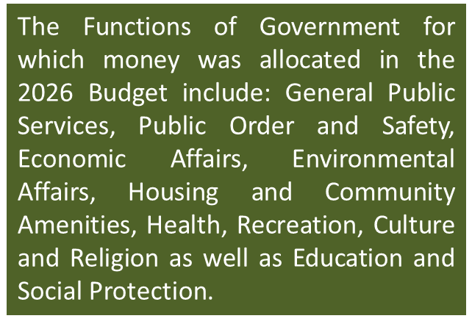
Gombe State Government 2026 Approved Budget - Total Expenditure by Functional Classification (COFOG)

Slide 29
Opportunities for Public Participation in 2026 Budget
Citizens have opportunities to participate in the State Budget process in order to ensure that decision-making in public finance is done appropriately. This can be done through the following ways:
Meeting with MDAs by engaging them to understand their budget implementation process and give in their inputs or contributions to aid in periodic budget review.
Engage decision makers to determine best options in addressing Communities’ need and chat ways of addressing their concerns.
Citizens can request for information on projects awarded to contractors in their communities in terms of cost, project description, location, standard, timeframe, etc. so that they can monitor and ensure that the right things are done. Contract information can also be gathered from the Open Contracting Data Portal of the Gombe State Due Process Bureau.
Citizens can submit feedback on projects executed in their communities to inform the government on the pace of the projects in their communities and any gaps observed.
Citizens can participate in the Citizens Accountability Report (CAR) presentation meetings at the zonal levels.
Citizens can attend Budget Review meetings at the State House of Assembly.

Slide 30
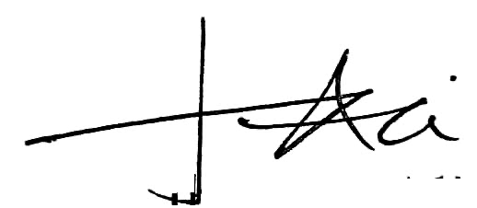
For more Information & Enquiry, contact
Salihu Baba Alkali
Hon. Commissioner, Ministry of Budget & Economic Planning
08065175711
sbalkali@yahoo.co.uk
Muhammad Gambo Magaji
Hon. Commissioner, Ministry of Finance
08033139948
mgm262@yahoo.com
Jalo Ibrahim Ali, mni
Permanent Secretary, Ministry of Budget & Economic Planning
08034140577
Jaloali45@gmail.com
Kabiru Tsoho
Director General, Debt Management Agency and (Focal Person SABER)
08035885655
Kabirutsoho38@gmail.com

Slide 31
GOMBE STATE
BUDGET 2026
BUDGET OF CONSOLIDATION

