Slide 1
GOMNATIN JIHAR GOMBE
KASAFIN KUDI
NA SHEKARAR 2025
KASAFI DOMIN FARFADOWA DA AIKI TUKURU
KASAFIN KUDI DOMIN AL’UMMA NA SHEKAR 2025 WANDA MA’IKATAR KASAFIN KUDI DA TSARE-TSARE TA WALLAFA
JANAIRU, 2025

Slide 2
Gabatarwa
A kokarinta da takeyi wajen wayar da kan jamaár Jihar Gombe da sauran masu sha’awar bibiyar kasafin kudin jihar na shekarar 2025, ma’aikatar kasafin kudi da tsare-stare tayi wannar gajeriyar wallafa domin ilmantar da jama’a sha’anin kasafin kudin Gomnatin jihar Gombe daga shekara zuwa shekara, ta hanyar samar da bayani akan kasafin kudin musamman akan hasashen da ake dashi akan nawa ake tsammanin samu, daga wadanne hanyoyi, kuma ta yaya za’ayi amfani da kudaden da aka samu, yana da matukar muhimmanci ga jama’a.
Manufar wannar wallafa shine jama’a da sauran masu ruwa da tsaki zasu samu damar bada tasu gudumawa wajen ganin tsare-tsaren Gomnati sun tafi yadda ya kamata.
Kasafin kudin 2025 anyi masa take da Kasafi Domin Farfadowa da Aiki Tukuru wanda keda zummar cigaba da ayyukan alkhairi da Gomnati mai ci ke gudanarwa

Slide 3
Kasafin Kudi Domin Al’umma: wannar wata wallafa ce da Gomnati ta kanyi a sawwake domin al’umma su fahimci yadda Gomnati take kasafin kudaden ta domin kowa ya fahimci yadda kudaden Gomnati ke amfanar al’umma. Akan wallafa shi ne ta harshen da mutane suka fi fahimta. Kasafin Kudi: wannan wani tsarin hasashe ne da Gomnati takanyi akan kudaden da take sa ran samu da kuma yadda zata kashe su na tsawon lokaci wanda akan yishi a shekara. Tsari ne wanda Gomnati take yi domin samar da kudaden shiga da kuma ta yadda za’a kashe su akan ayyuka da manufofin Gomnati domin al’umma kudin Shiga: wadannan kudade ne da Gomnati take da kwarin gwiwar zata samu a shekaran kasafin kudi. Ana samun kudin ne daga rabonnin Gomnatin tarayya, harajin cikin gida, tallafi daga ciki da wajen kasa da sauransu. Kashe Kudi: wannan shine tsarin da Gomnati take yi domin sarrafa kudin da ta samu. Kudin akan kashe su ne a madadin al’umma ta hanyoyi biyu kamar haka: Manyan Ayyuka, Albashi, gudanar da Gomnati tare da biyan basussuka. Manyan Ayyuka: wannan tsari ne da Gomnati take yi domin kashe kudi akan manyan ayyuka kamar gina tituna, da sauran gineginen gwamanti, samar da lafiya, Ilimi, wajen ayyukan Gomnati, kiyaye muhalli, wutan lantarki, samar da kayan tsaro, da sauransu. Albashi da Gudanar da Gomnati: wannan tsarin kashe kudi ne da gwamanti take yi akan albashin ma’aikata, da kuma gudanar da gomnati kamar tafiye tafiye, biyan kudin wuta, sayen mai na motoci da injunan wuta da ruwa, sayen kayayyakin gudanar da ofis, kananan gyare gyare da sauransu. .
MA’ANAR ABUBUWAN DA KASAFIN KUDI YA KUNSA

Slide 4
Bashi: wannan wani tsari ne da gomnati take yi domin ranto kudi daga Bankin Duniya, Bankunan cikin gida, ko kuma masu saka hannun jari domin yin manyan ayyuka, da kudaden shiga baza su iya aiwatarwa ba. Ana biyan kudaden ne ta hanyar biya kai tsaye daga kason jihar wajen rabon wata – wata na tarayya.

Slide 5
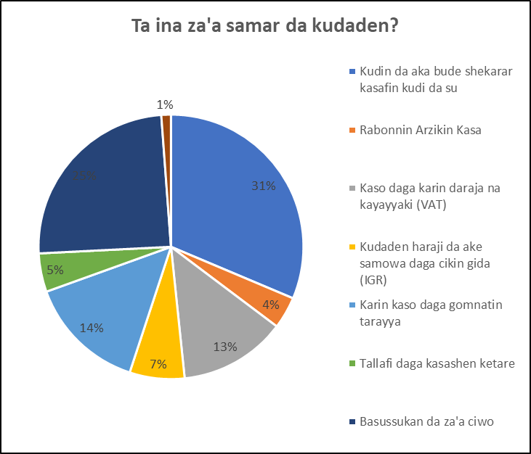
Ta ina za'a samar da kudin?
 | Kudin Shiga | Kasafin 2025
 | Kudin da aka bude shekarar kasafiin kudi da su | 120,000,000,000
 | Rabonnin Arzikin Kasa | 15,000,000,000
 | Kaso daga karin karin daraja na kayayyaki (VAT) | 50,000,000,000
 | Kudaden haraji da ake samowa daga cikin gida (IGR) | 25,660,245,000
 | Karin kaso daga Gomnatin tarayya | 55,250,000,000
 | Tallafi daga kasashen ketare | 18,020,000,000
 | Basussukan da za'a ciwo | 94,200,000,000
 | Kudin da ake tsammani domin manyan Ayyuka | 4,500,000,000
 | Jimillar Kudin da ake Saran Samu | 382,630,245,000

Slide 6
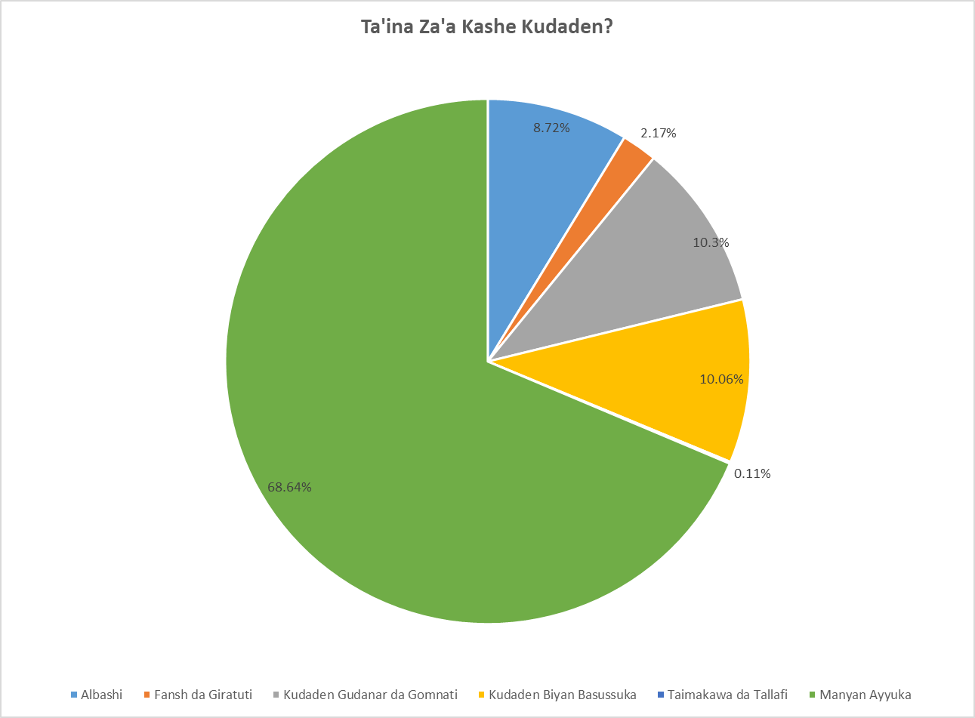
 | Inda za'a kashe kudin | Kasafin 2025
 | Albashi, Fansho da Giratuti | 40,279,765,000
 | Albashi | 32,245,765,000
 | Fansho da Giratuti | 8,034,000,000
 | Sauran Kudaden gudanar da Gomnati | 75,724,950,000
 | Kudaden gudanar da Gomnati | 38,088,750,000
 | Kudaden biyan basussuka | 37,225,000,000
 | Taimakawa da Tallafi | 411,200,000
 | Manyan Ayyuka | 253,897,785,000
 | Jimillar Kudin da za'a kashe | 369,902,500,000

Slide 7
Tallafi da ake Tsammani daga Hukumomin da ke Tallafawa domin ci gaba
 | Tallafi daga Hukumoim Cikin Gida | Kasafin 2025
 | Hukumomin da zasu Bayar da Kudin
 | Kudaden da Gomnatin tarayya zata samar domin gudanar da manyan ayyukan gomnatin jiha | 15,720,000,000
 | Jimillar Tallafi daga cikin gida/kasa | 15,720,000,000
 | Tallafi daga Kasashen Ketare | Kasafin 2025
 | Hukumomin da zasu Bayar da Kudin daga ketare
 | Kudin da ake samarwa domin manyan Ayyuka daga kasashen ketare | 2,300,000,000
 | Jimillar Tallafi daga Kashen ketare | 2,300,000,000
Daga Ina Za’a Ciwo Bashin?
 | Bashin da za’a ciwo a cikin Gida | Kasafin 2025
 | Inda Za’a ciwo Bashin
 | Rance daga Bakunan Kasuwanci | 2,000,000,000
 | Rance daga Hukumomi dake hada - hadan Hannayen Jari | 5,000,000,000
 | Jimillar Bashin da Za’a ciwo daga Cikin Gida | 7,000,000,000
Bashin da Za’a Ciwo daga Kasashen ketare | Kasafin 2025
Inda Za’a ciwo Bashin
Bashin da za’a ciwo daga Bankin Duniya | 87,200,000,000
Jimillar Bashin da Za’a ciwo daga kasashen Ketare | 87,200,000,000

Slide 8
Babban Manufar Gomnatin Jihar Gombe a Kasafin Kudin 2025
Kasafin Shekarar 2025 yafi maida hankali ne wajen tabbatar da samar da abubuwa kamar haka:
Samar da ci gaban tattalin arziki mai dorewa,
Fadada hanyoyin bunkasa tattalin arziki, da
Inganta hanyoyin samar da aiki mai nagarta.
Haka kuma wadannan muhimman abubuwa da aka lissafa zasu taimaka wajen habaka hukumomi mafiya muhimmanci kamar Hukumomin Ilimi, Kiwon lafiya, Noma, Samar da Tsaftataccen ruwan sha da kuma ci gaba da samar da ababen more rayuwa wanda za su yi daidai da tsarin Kundin ci gaba na Jiha (DEVAGOM) da kuma cimma muradun karni (SDGs).

Slide 9
 | Kudin da za’a Kashe a Manyan Bangarorin Gomnati
 | Manyan Bangarori | Kasafin 2025
 |  | Kudaden Gudanarwa |  | Kudaden Manyan Ayyuka |  | Jimillar Kudin da za’a kashe
 | Bangaren Gudanar da Gomnati | 34,578,530,000 |  | 9,488,000,000 |  | 44,066,530,000
 | Bangaren Tattalin Arziki | 48,321,445,000 |  | 178,403,600,000 |  | 226,725,045,000
 | Bangaren Shari’a | 3,982,720,000 |  | 3,908,000,000 |  | 7,890,720,000
 | Bangaren Jind dadin Al’umma | 29,122,020,000 |  | 62,098,185,000 |  | 91,220,205,000
 | Jimillar Kudin da za’a kashe | 116,004,715,000 |  | 253,897,785,000 |  | 369,902,500,000

Slide 10
 | Kudin da za’a kashe a Bangaren Gudanar da Sassan Gomnati
 | Ayyukan Gona | Ciniki da Masana’antu | Ilimi | Ruwa da Muhalli | kudi da Tsara Tattalin Arziki | Gudanar da Harkokin Gomnati
 | N907,800,000 Million | N288,000,000 Million | N16,343,670,000 Billion | N1,343,710,000 Billion | N43,419,150,000 Billion | N34,526,530,000 Billion
 | Lafiya | Ababen More Rayuwa | Shari’a | Mata, Matasa da Wasanni | Sauran Bangarorin
 |  |  |  |  | Sauran Bangarori
 | N22,774,000,000 Billion | N1,055,035,000 Billion | N3,982,720,000 Billion | N1,270,350,000 Billion | N9,906,250,000 Billion
Kudin da za’a kashe a Bangaren Gudanar da Manyan Ayyuka a Sassan Gomnati
Ayyukan Gona | Ciniki da Masana’antu | Ilimi | Ruwa da Muhalli | kudi da Tsara Tattalin Arziki | Gudanar da Harkokin Gomnati
N11,884,000,000 Billion | N4,052,000,000 Billion | N37,311,500,000 Billion | N57,784,500,000 Billion | N14,055,000,000 Billion | N9,438,500,000 Billion
Lafiya | Ababen More Rayuwa | Shari’a | Mata, Matasa da Wasanni | Sauran Bangarorin
 |  |  |  | Sauran Bangarori
N21,505,685,000 Billion | N84,415,500,000 Billion | N3,908,000,000 Billion | N3,215,500,000 Billion | N6,327,600,000 Billion

Slide 11
 | HUKUMOMI GOMA DA ZA SU FI KASHE KUDADE WURIN BIYAN ALBASHI, ALAWUS DA KUMA GUDANAR DA GOMNATI
 | HUKUMA | KASAFIN 2025
 |  | Jimillar Kudin da za’a Kashe
 | Ma’aikatar Kudi da Ci gaban Tattalin Arziki | 43,419,150,000
 | Ofishin Gomna | 19,053,800,000
 | Ma’akatar Lafiya | 11,335,000,000
 | Ma’aikatar Ilimi mai Zurfi | 8,344,730,000
 | Ma’aikatar Ilimi | 7,998,940,000
 | Ofishin Sakataren Gomnati | 6,159,150,000
 | Majalisar Dokokin Jiha | 6,122,400,000
 | Hukumar Hidimar ma’aikatan sharia | 2,713,670,000
 | Ma’aikatar Ruwa, Muhalli da Albarkatun Gandun Daji | 1,343,710,000
 | Ma’aikatar Ayyuka, Gidaje da Sufuri | 1,055,035,000
 | Sauran Hukumomi | 8,459,130,000
 | Jimillar Kudin da za’a Kashe | 116,004,715,000
 | HUKUMOMI GOMA DA ZA SU FI KASHE KUDADE A KAN MANYAN AYYUKA
 | HUKUMA | KASAFIN 2025
 |  | Kudin da za’a kashe
 | Ma’aikatar Ayyuka, Gidaje da Sufuri | 84,415,500,000
 | Ma’aikatar Ruwa, Muhalli da Albarkatun Gandun Daji | 57,784,500,000
 | Ma’aikatar Ilimi | 25,242,500,000
 | Ma’aikatar Lafiya | 21,456,185,000
 | Ma’aikatar Kudi da Ci gaban Tattalin Arziki | 14,055,000,000
 | Ma’aikatar Ilimi mai Zurfi | 12,069,000,000
 | Ma’aikatar Noma, Kula da Dabbobi da Kungiyoyin Gama kai | 11,884,000,000
 | Ofishin Gommna | 5,019,500,000
 | Ma’aikatar Ciniki, Masana’antu da Yawon Bude Ido | 4,052,000,000
 | Ma’aikatar Kasafin Kudi da Tsara Tattalin Arziki | 3,040,000,000
 | Sauran Hukumomi | 14,879,600,000
 | Jimillar Kudin da za’a Kashe | 253,897,785,000

Slide 12
Wassu daga Ayyukan da Al’umma suke Bukata a sanya musu a kasafin 2025
Gina Hanyar Mota daga garin Biri zuwa Dukku – ₦10,000,000.00
Gina Hanyar Mota daga garin Luggerewo – Garin Baraya – Mbarri – Mai Shanu – Mai Ganga with a spur to Piyau – Sambo Daji – ₦10,000,000.00
Magance matsalar zaizayar kasa a garin Gadawo, karamar hukumar Akko ₦10,000,000.00
Kwaskwarima tare da fadada hanyar mota daga Kwanan Jarkwami tare ratse wanda ya tashi daga Titi – Madu kellumi zuwa kalam dake Karamar hukumar Kwami a matakin farko na tsawon kilomita 25 ₦5,000,000.0
Gina kananan gadoji a gundumomi 6 dake fadin jiha ₦25,000,000.00
Kaurarwa tare da sake gina wurin koyar da sana’o’in hannu dake garin Tongo a karamar hukumar Funakaye ₦50,000,000.00
Gina Hanyar Mota daga garin Malala – Zaune – Dukkuyel – ₦200,000,000.00

Slide 13
Damar da Al’umma keda ita Domin Bada Gudumawa a Kasafin 2025
Al’umma na da damammaki da yawa da za su bayar domin tabbatar da cewa kudaden jiha anyi amfani dasu ta hanyar da ta dace. Wassu daga cikin hanyoyin tabbatar da haka sun hada da:
Ganawa da hukumomin da suka dace domin sanin hanyoyin da za su su bi don bada gudumawar su a lokutan kasafin kudi.
Ganawa tare da masu fada aji don basu shawarwari akan hanyoyin da za su bi domin magance matsalolin yankunan su, don su sami sauki wajen cimma bukatun su.
Al’umma za su iya neman bayanai kan manyan ayyuka da Gomnati ta bayar ayi a yankunan su wanda ya hada da Irin aikin da aka bayar, inda za’ayi shi, kudin da aka ware wa aikin, ingancin sa, lokacin da aka daukar wa aikin, da sauransu don tabbatar da cewa anyi shi bisa yanda aka tsara. Za kuma a iya shiga manhajar tabbatar da bin tsarin ayyuka na Jiha wato (Due Process) don ganin irin tsarin aikin da aka bayar.
Al’umma zasu iya bayar da bayanai kan yadda ake tafiyar da manyan ayyuka da ake yi a yankunan su, tare da tsekon da ayyukan suke fuskanta.
Al’umma zasu iya bada gudumawa a kasafin kudi yayin ganawa da akeyi a matakin mazabu wato (Senatorial Zones) wanda Maikatar kudi tare da hadin gwiwar Ma’aikatar Kasafin Kudi da Tsare-Tsare kan Shirya duk shekara.
Al’umma zasu iya halartar bayar da bahasi akan kasafin kudi da ma’aikatun Gomnati ke yi a harabar majalisar dokoki ta jiha don sanin me aka tsara a kasafin kudin shekara.

Slide 14
Domin Neman Karin Bayani, Tuntubi:
Salihu Baba Alkali
Komishina, Ma’aikatar Kasafin Kudi Da Tsare Tsare
08065175711
sbalakali@yahoo.co.uk
Muhammad Gambo Magaji
Komishina, Ma’aikatar Kudi
08033139948
mgm262@yahoo.com
Jalo I Ali, mni
Sakataren Dindindin Na Ma’aikatar Kasafin Kudi Da Tsare Tsare
08034140577
Jaloali45@gmail.com
Kabiru Tsoho
Darakta Janar a Hukumar kula da Bassuka ta Jiha
08035885655
Kabirutsoho38@gmail.com

Slide 15
GOMNATN JIHAR GOMBE
KASAFIN KUDI
DOMIN AL’UMMA
NA SHEKARAR 2025
KASAFIN DOMIN FARFADOWA DA AIKI TUKURU

