Slide 1
GOMBE STATE GOVERNMENT
2025 BUDGET
BUDGET OF COMMITMENT AND RESILIENCE
2025 CITIZENS’ BUDGET
BY
Ministry of Budget and Economic Planning
GOMBE STATE
JANUARY, 2025

Slide 2
Introduction
In its effort to create awareness to the people of Gombe State on the 2025 Budget, the Ministry of Budget and Economic Planning has published this summary document to enlighten the public on the State annual budget. It provides information on the budget, especially on the areas of expected income, its sources and expenditure which are key to the public.
The aim of this publication is to provide an insight to the public on Government utilization of public finances for the year.
The 2025 Budget is tagged “Budget of Commitment and Resilience” which was meant to show continuity in the government commitment in serving the interest of the good people of Gombe State.

Slide 3
Definition of some Budget Terminologies
Citizens Budget: this is a document developed by the Government mainly for the understanding of general public, and it presents the budget in a simpler, less technical format, to ensure a better understanding of how public finances are managed.
The document is written in simple language and incorporate visual elements to help non-specialized readers understand the information better.
Budget: it is an annual estimate of income and expenditure for the State. It is therefore, a plan on how Government expects to raise revenue (money) and how to spend it on specific projects and programmes within a specific timeframe, usually one year.
Revenue: this is the amount of money that Government expect to receive during the year. This is mostly the money received from the Federation Accounts Allocation Committee (FAAC), Internally Generated Revenue (IGR), Grants, aids, loans/credits, etc.
Expenditure: this has to do with how Government plans to spend the money it received. The money spent on behalf of the citizens is in two (2) ways, namely: Recurrent and Capital Expenditures.
Recurrent Expenditure: these are expenditures of day to day activities of Government, which include salaries and allowances which are paid to employees; operational costs such as transport, travelling, electricity and water bills , office & residential rent, maintenance of government assets, feeding of school children and subsidy on Education, Health of the people, etc.
Capital Expenditure: these are monies spent by Government on fixed and capital projects that are of both tangible and intangible in nature, which include expenditure on Land, building, construction of roads, bridges, drainages, provision of electricity facilities, furniture, vehicles, security gadgets, etc.
Loan/Credits: This refers to a credit in which a sum of money is lent to the state in exchange for future repayment on the value or principal amount. In many cases, the lender also adds interest or finance charges to the principal value, which the borrower must repay in addition to the principal balance.

Slide 4
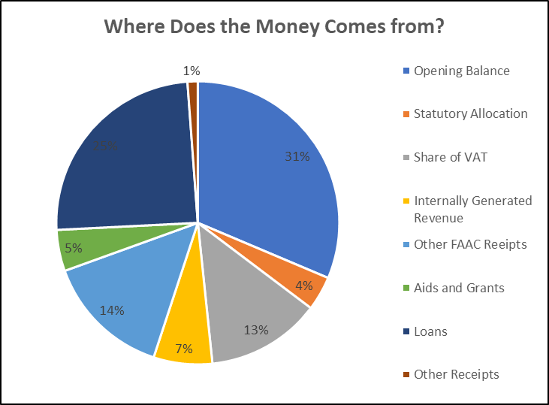
Where Does the Money Come from?
 | Revenue | 2025 Budget
 | Opening Balance | 120,000,000,000
 | Statutory Allocation | 15,000,000,000
 | VAT | 50,000,000,000
 | Other FAAC Receipts | 55,250,000,000
 | Aids and Grants | 18,020,000,000
 | Loans | 94,200,000,000
 | Other Receipts | 4,500,000,000
 | Internally Generated Revenues | 25,660,245,000
 | Total Revenue (including Opening Balance) | 382,630,245,000

Slide 5
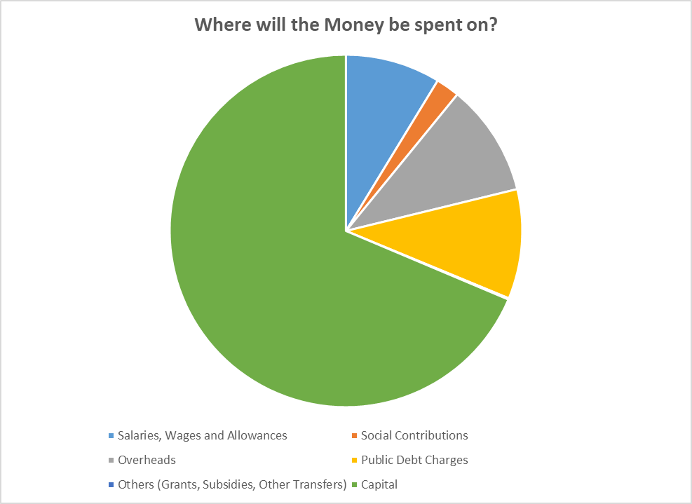
Where will the Money be Spent on?
 | Expenditure | 2025 Budget
 | Personnel cost & Social Contribution | 40,279,765,000
 | Salaries, Wages and Allowances | 32,245,765,000
 | Social Contributions | 8,034,000,000
 | Other Recurrent | 75,724,950,000
 | Overheads | 38,088,750,000
 | Public Debt Charges | 37,225,000,000
 | Others (Grants, Subsidies, Other Transfers) | 411,200,000
 | Capital | 253,897,785,000
 | Total Expenditure (including Contingencies) | 369,902,500,000
8.72%
2.17%
10.3%
68.64%
10.06%
0.11%

Slide 6
Where will the Grants Comes from?
Domestic Grants | 2025 Budget
Source and Purpose (where applicable)
Grant from FGN | 15,720,000,000
Total Domestic Aids and Grants | 15,720,000,000
Foreign Grants | 2025 Budget
Source and Purpose (where applicable)
Capital Foreign Grants | 2,300,000,000
Total Foreign Loans | ₦2,300,000,000.00
Where will the Loans be Borrowed from?
 | Domestic Loans (Top 3) | 2025 Budget
 | Source (and Purpose where applicable)
 | Borrowing from Financial Institutions | 2,000,000,000
 | Borrowing from other Capital Markets | 5,000,000,000
 | Total Domestic Loans | 7,000,000,000
Foreign Loans (Top 5) | 2025 Budget
Source and Purpose
Borrowing from World Bank | 87,200,000,000
Total Foreign Loans | 87,200,000,000

Slide 7
2025 Priority Areas in Gombe State Budget
The priority areas for 2025 Fiscal Year Budget is geared towards achieving the following:
Sustainable and Inclusive socio-economic Growth,
Diversification of the Economy, and
To improve access to more qualitative service.
Equally, the key priorities will be to continue to stimulate rapid economic growth in the real sectors of the State economy notably, Education, Health, Agriculture, WASH and continuous provision of critical Infrastructure, empowerment, and social protection initiatives that will fast tract the attainment of DEVAGOM and the Sustainable Development Goals (SDGs).

Slide 8
 | How much have we allocated to each of the Sectors both Recurrent & Capital, and for what?
 | Expenditure by Main Sector | 2025 Budget
 |  | Total Recurrent Expenditure |  | Total Capital Expenditure |  | Total Expenditure
 | Administration Sector | 34,578,530,000 |  | 9,488,000,000 |  | 44,066,530,000
 | Economic Sector | 48,321,445,000 |  | 178,403,600,000 |  | 226,725,045,000
 | Law and Justice Sector | 3,982,720,000 |  | 3,908,000,000 |  | 7,890,720,000
 | Social Services Sector | 29,122,020,000 |  | 62,098,185,000 |  | 91,220,205,000
 | Total Expenditure | 116,004,715,000 |  | 253,897,785,000 |  | 369,902,500,000

Slide 9
 | Recurrent Expenditure by Sector
 | Agriculture | Commerce and Industry | Education | Water/Environment | Finance and Economic Planning | General Government Administration
 | N907,800,000 Million | N288,000,000 Million | N16,343,670,000 Billion | N1,343,710,000 Billion | N43,419,150,000 Billion | N34,526,530,000 Billion
 | Health | Infrastructure | Law and Justice | Water/Environment | Other
 |  |  |  |  | Others
 | N22,774,000,000 Billion | N1,055,035,000 Billion | N3,982,720,000 Billion | N1,270,350,000 Billion | N9,906,250,000 Billion
Capital Expenditure by Sector
Agriculture | Commerce and Industry | Education | Water/Environment | Finance and Economic Planning | General Government Administration
N11,884,000,000 Billion | N4,052,000,000 Billion | N37,311,500,000 Billion | N57,784,500,000 Billion | N14,055,000,000 Billion | N9,438,500,000 Billion
Health | Infrastructure | Law and Justice | Women, Youth and Sports | Other
 |  |  |  | Others
N21,505,685,000 Billion | N84,415,500,000 Billion | N3,908,000,000 Billion | N3,215,500,000 Billion | N6,327,600,000 Billion

Slide 10
 | Top MDAs with Recurrent Expenditure Allocations
 | MDA | 2025 Budget
 |  | Expenditure Allocation
 | Ministry of Finance and Economic Development | 43,419,150,000
 | Governor’s Office | 19,053,800,000
 | Ministry of Health | 11,335,000,000
 | Ministry of Higher Education | 8,344,730,000
 | Ministry of Education | 7,998,940,000
 | Office of the Secretary to the State Government | 6,159,150,000
 | Gombe State House of Assembly | 6,122,400,000
 | Judicial Service Commission | 2,713,670,000
 | Ministry of Water Resources, Environment and Forest Resources | 1,343,710,000
 | Ministry of Works, Housing and Transport | 1,055,035,000
 | Others | 8,459,130,000
 | Total Expenditure | 116,004,715,000
 | Top MDAs with Capital Expenditure Allocations
 | MDA | 2025 Budget
 |  | Expenditure Allocation
 | Ministry of Works, Housing and Transport | 84,415,500,000
 | Ministry of Water ,Environment and Forest Resources | 57,784,500,000
 | Ministry of Education | 25,242,500,000
 | Ministry of Health | 21,456,185,000
 | Ministry of Finance and Economic Development | 14,055,000,000
 | Ministry of Higher Education | 12,069,000,000
 | Ministry of Agriculture, Animal Husbandry and Cooperatives | 11,884,000,000
 | Governors Office | 5,019,500,000
 | Ministry of Trade, Industry and Tourism | 4,052,000,000
 | Ministry of Budget and Economic Planning | 3,040,000,000
 | Others | 14,879,600,000
 | Total Expenditure | 253,897,785,000

Slide 11
Some Projects Suggested by the Citizens in 2025
Road Construction from Biri to Dukku in Dukku & Nafada LGAs – ₦10,000,000.00
Road construction fro Malala – Zaune – Dukkuyel in Dukku LGA – ₦200,000,000.00
Construction of road from Luggerewo – Garin Baraya – Mbarri – Mai Shanu – Mai Ganga with a spur to Piyau – Sambo Daji in Akko LGA – ₦10,000,000.00
Erosion control at Gadawo Community in Akko LGA – ₦10,000,000.00
- Upgrade/Surface dressing from Kwanan Gerkwami with spur from Titi to Madu kellumi up to Kalam road 25km Phase 1 in Kwami LGA ₦5,000,000.00
Construction of mini culvert/bridge by six CDAs ₦25,000,000.00
Relocation/Reconstruction of Tongo Skill Acquisition Centre, Funakaye LGA ₦50,000,000.00

Slide 12
Opportunities for Public Participation in 2025 Budget
Citizens have opportunities to participate in the State Budget process in order to ensure that decision-making in public finance is done appropriately. This can be done through the following ways:
Meeting with MDAs by engaging them to understand their budget implementation process and give in their inputs or contributions to aid in periodic budget review.
Engage decision makers to determine best options in addressing Communities needs and chat ways of addressing their concerns.
Citizens can request for information on projects awarded to contractors in their communities in terms of cost, project description, location, standard, timeframe, etc. so that they can monitor and ensure that the right things are done. Contract information can also be gathered from the Open Contracting Data Portal of the Gombe State Due Process Bureau.
Citizens can submit feedback on projects executed in their communities to inform the government on the pace of the projects in their communities and any gaps observed.
Citizens can participate in the Citizens Accountability Report (CAR) presentation meetings at the zonal levels.
Citizens can attend Budget Review meetings at the State House of Assembly.

Slide 13
For more Information & Enquiry, contact
Salihu Baba Alkali
Hon. Commissioner, Ministry of Budget & Economic Planning
08065175711
sbalakali@yahoo.co.uk
Muhammad Gambo Magaji
Hon. Commissioner, Ministry of Finance
08033139948
mgm262@yahoo.com
Jalo Ibrahim Ali, mni
Permanent Secretary, Ministry of Budget & Economic Planning
08034140577
Jaloali45@gmail.com
Kabiru Tsoho
Director General, Debt Management Agency and (Focal Point SABER)
08035885655
Kabirutsoho38@gmail.com

Slide 14
GOMBE STATE
BUDGET 2025
BUDGET OF COMMITMENT AND RESILIENCE

